Slide 1
Module 2 - Strings

Slide 2
String
A string variable is a collection of characters inside double quotes.
Immutable

Slide 3
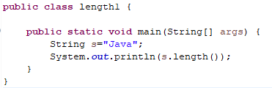
String Methods
str1.length() - Returns the length of a specified string.
OUTPUT: 4

Slide 4
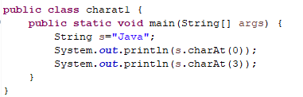
String Methods
charAt() - Returns the character at the specified index (position)
OUTPUT:

Slide 5

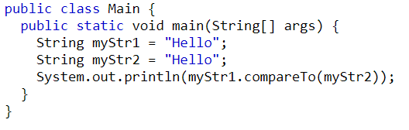

String Methods
compareTo() - Compares two strings
OUTPUT:

Slide 6
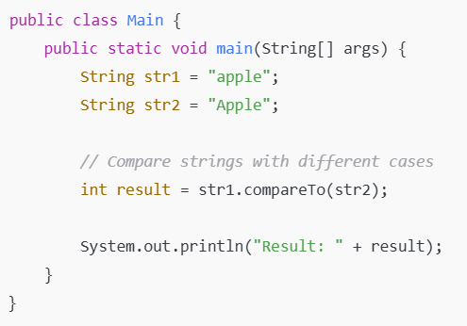

Slide 7
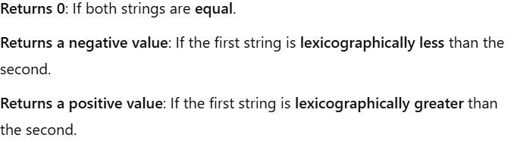

Slide 8

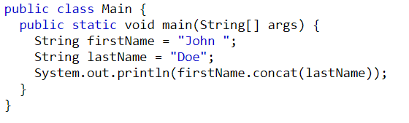

String Methods
concat() - Appends a string to the end of another string
OUTPUT:

Slide 9
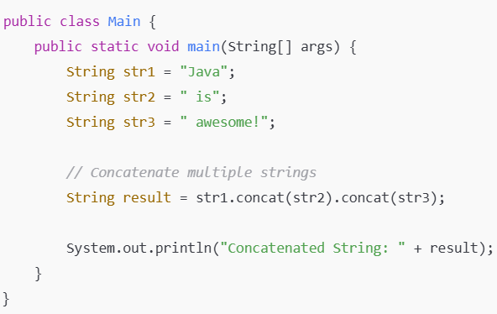

Concatenating Multiple Strings

Slide 10
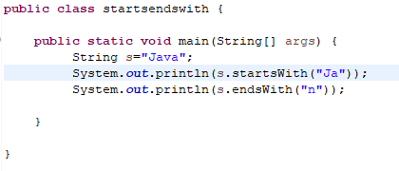

String Methods
startsWith() - Checks whether a string starts with specified characters
endsWith() - Checks whether a string ends with the specified character(s)
OUTPUT:

Slide 11
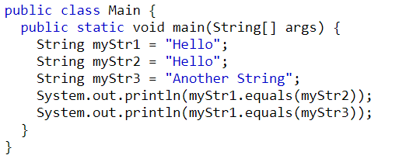

equals() - Compares two strings. Returns true if the strings are equal, & false if not

Slide 12
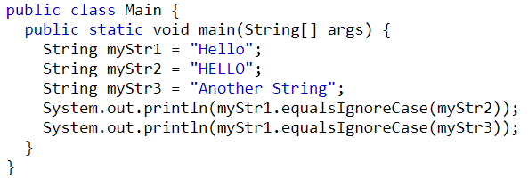
equalsIgnoreCase()- Compares two strings, ignoring case considerations

Slide 13
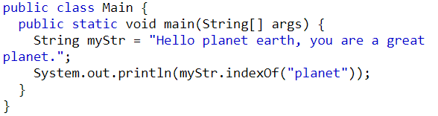
indexOf() - Returns the position of the first found occurrence of specified characters in a string
OUTPUT:

Slide 14
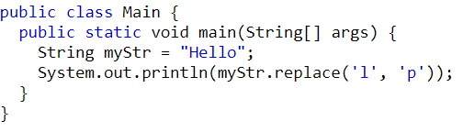
replace() - Searches a string for a specified value, and returns a new string where the specified values are replaced

Slide 15

replaceFirst() - Replaces the first occurrence of a substring that matches the given regular expression with the given replacement
replaceAll() - Replaces each substring of this string that matches the given regular expression with the given replacement

Slide 16
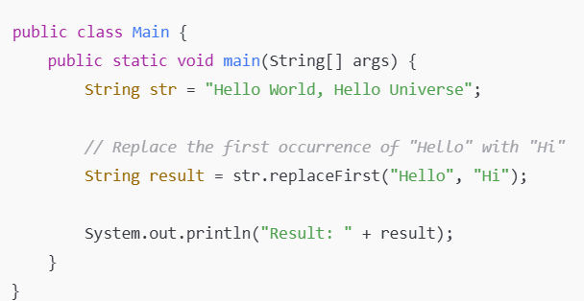


Slide 17
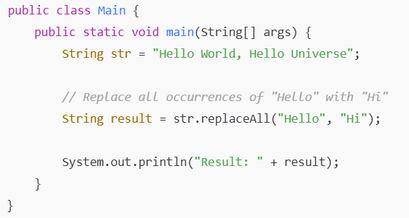

Slide 18
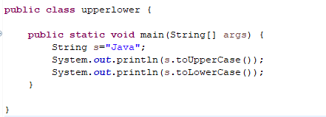

toLowerCase() - Converts a string to lower case letters
toUpperCase() - Converts a string to upper case letters

Slide 19
TRY
Write a Java program to remove all the white spaces from a string.
Write a Java program to remove all the white spaces from a user input string.
Write a Java program to get two strings from the user and concatenate them.

Slide 20
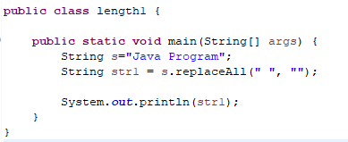
1

Slide 21
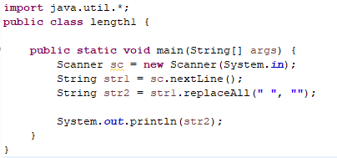
2

Slide 22
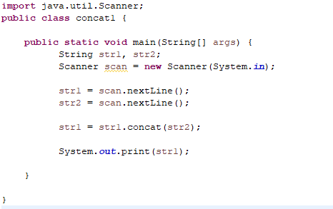
3

